Slide 1


Slide 2


Slide 3


Slide 4
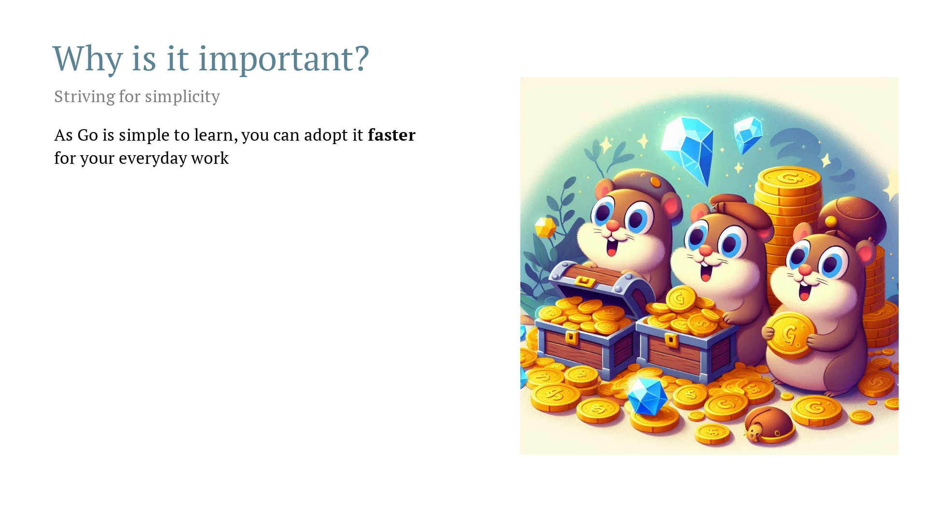

Slide 5


Slide 6


Slide 8


Slide 9


Slide 10
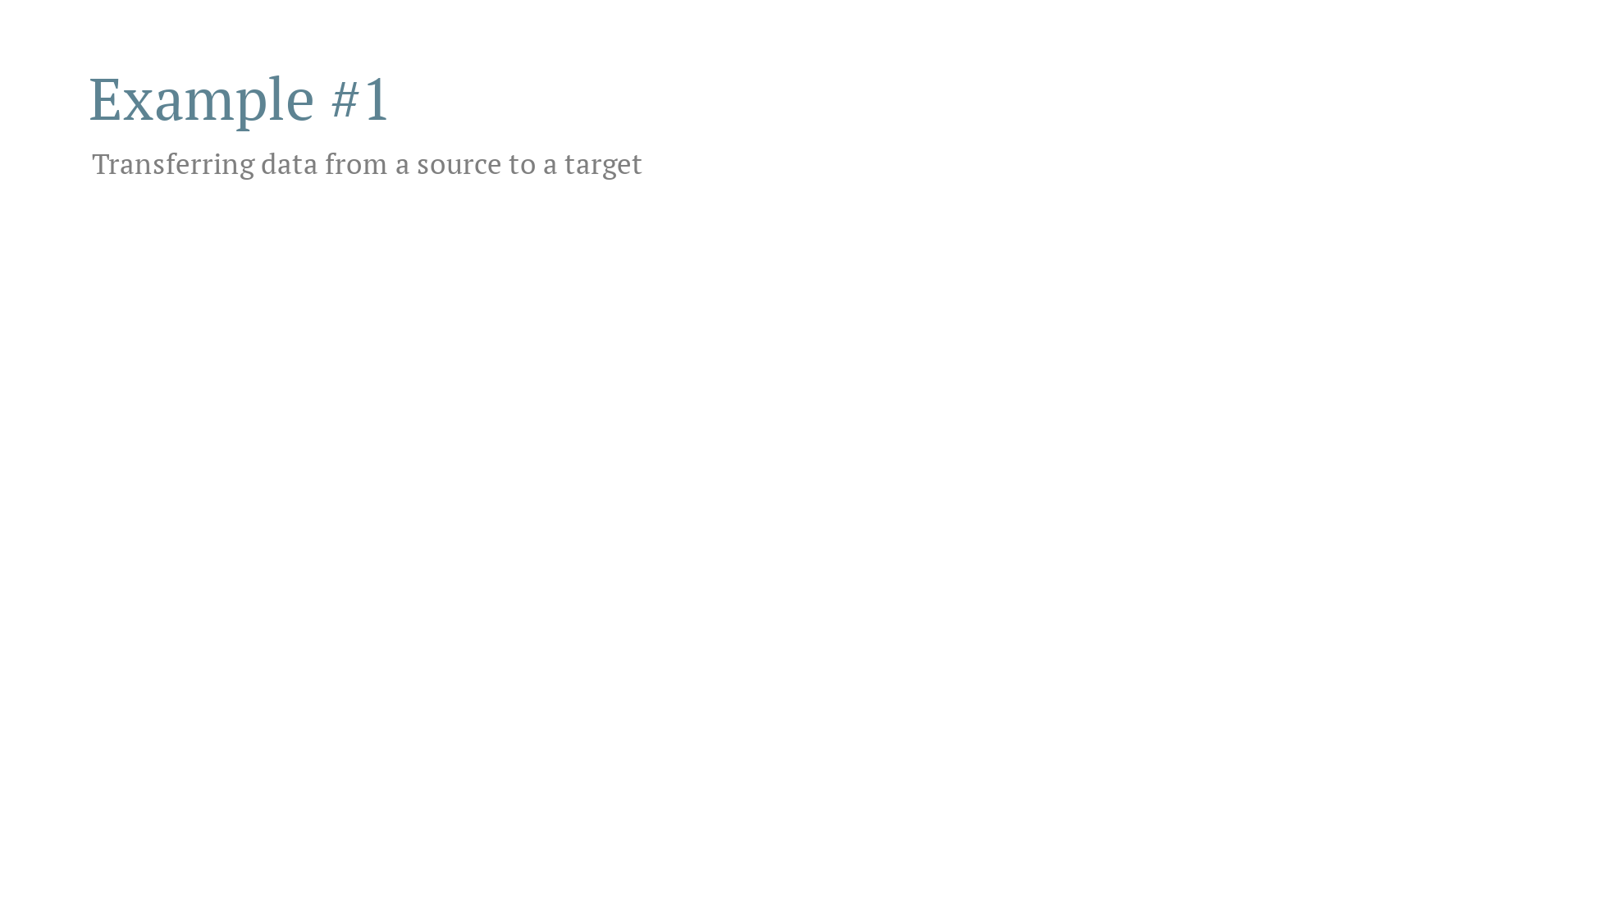

Slide 11
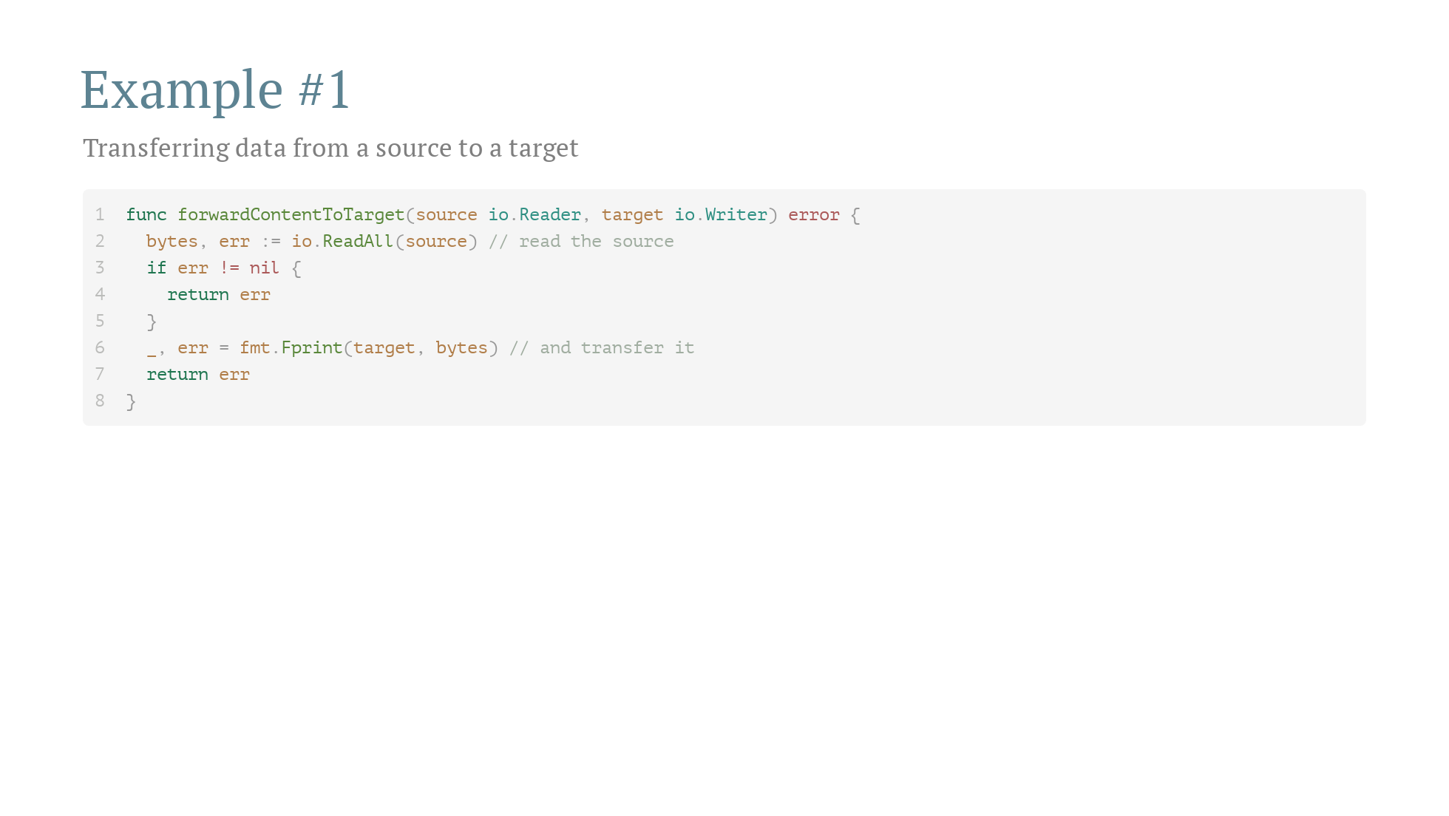

Slide 12
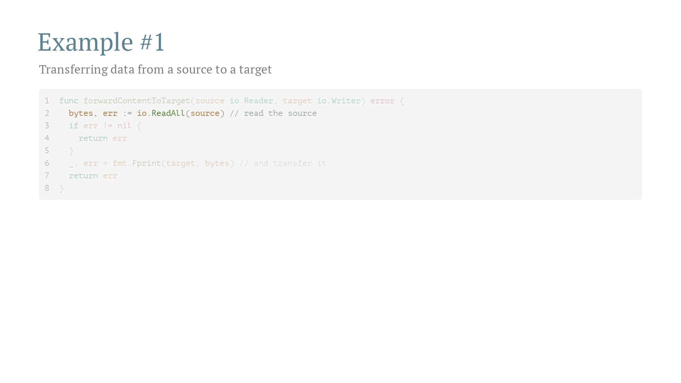

Slide 13
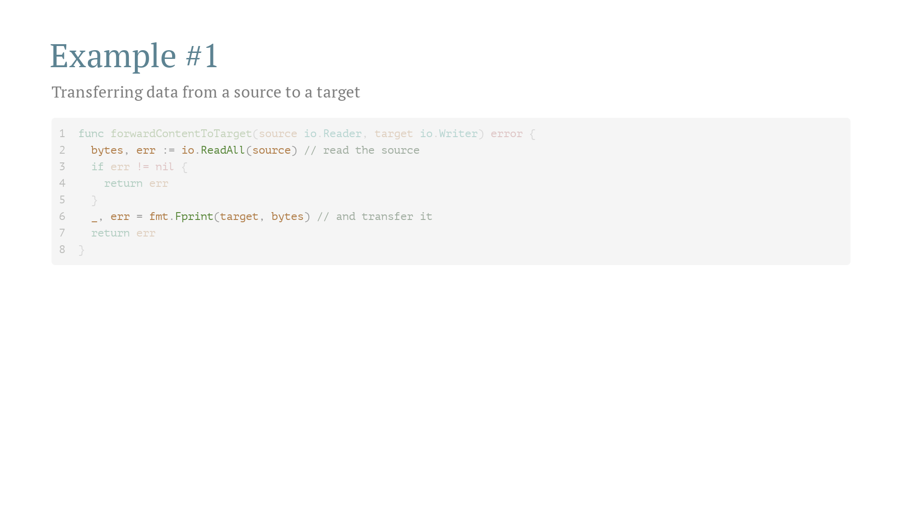

Slide 14
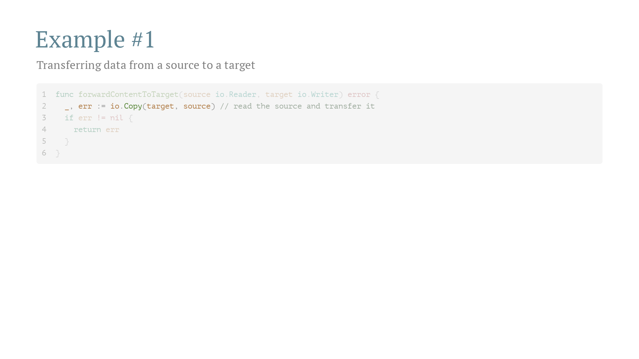

Slide 15
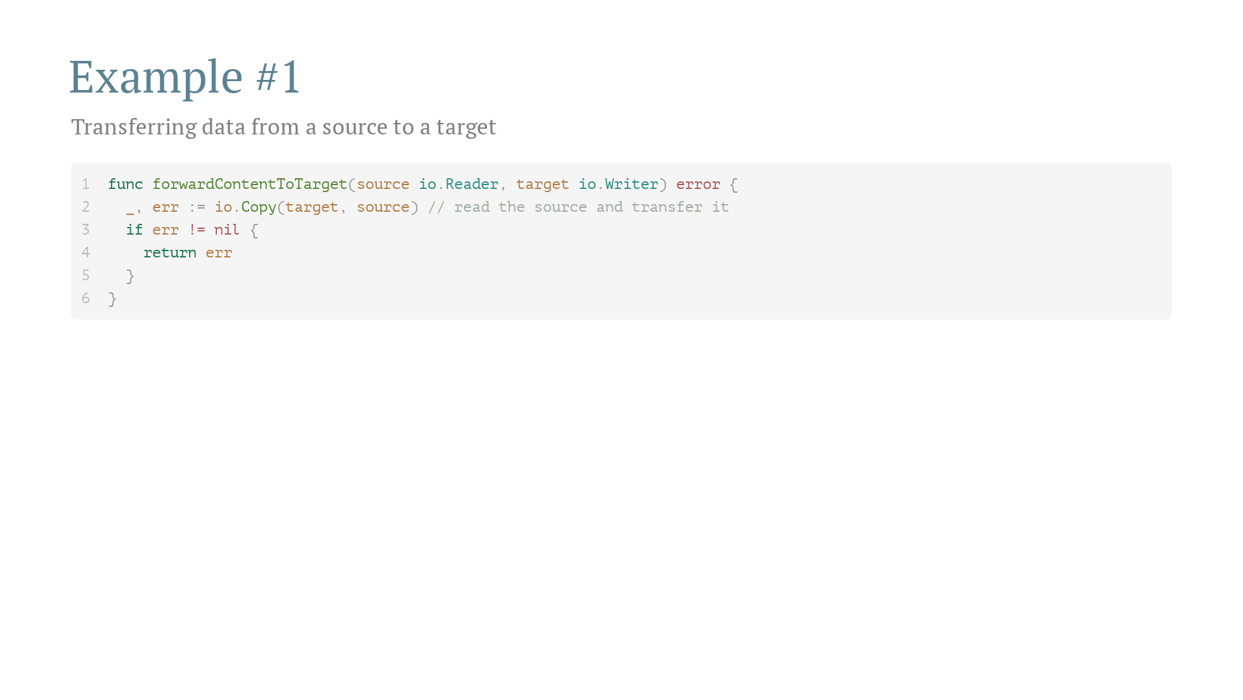

Slide 16
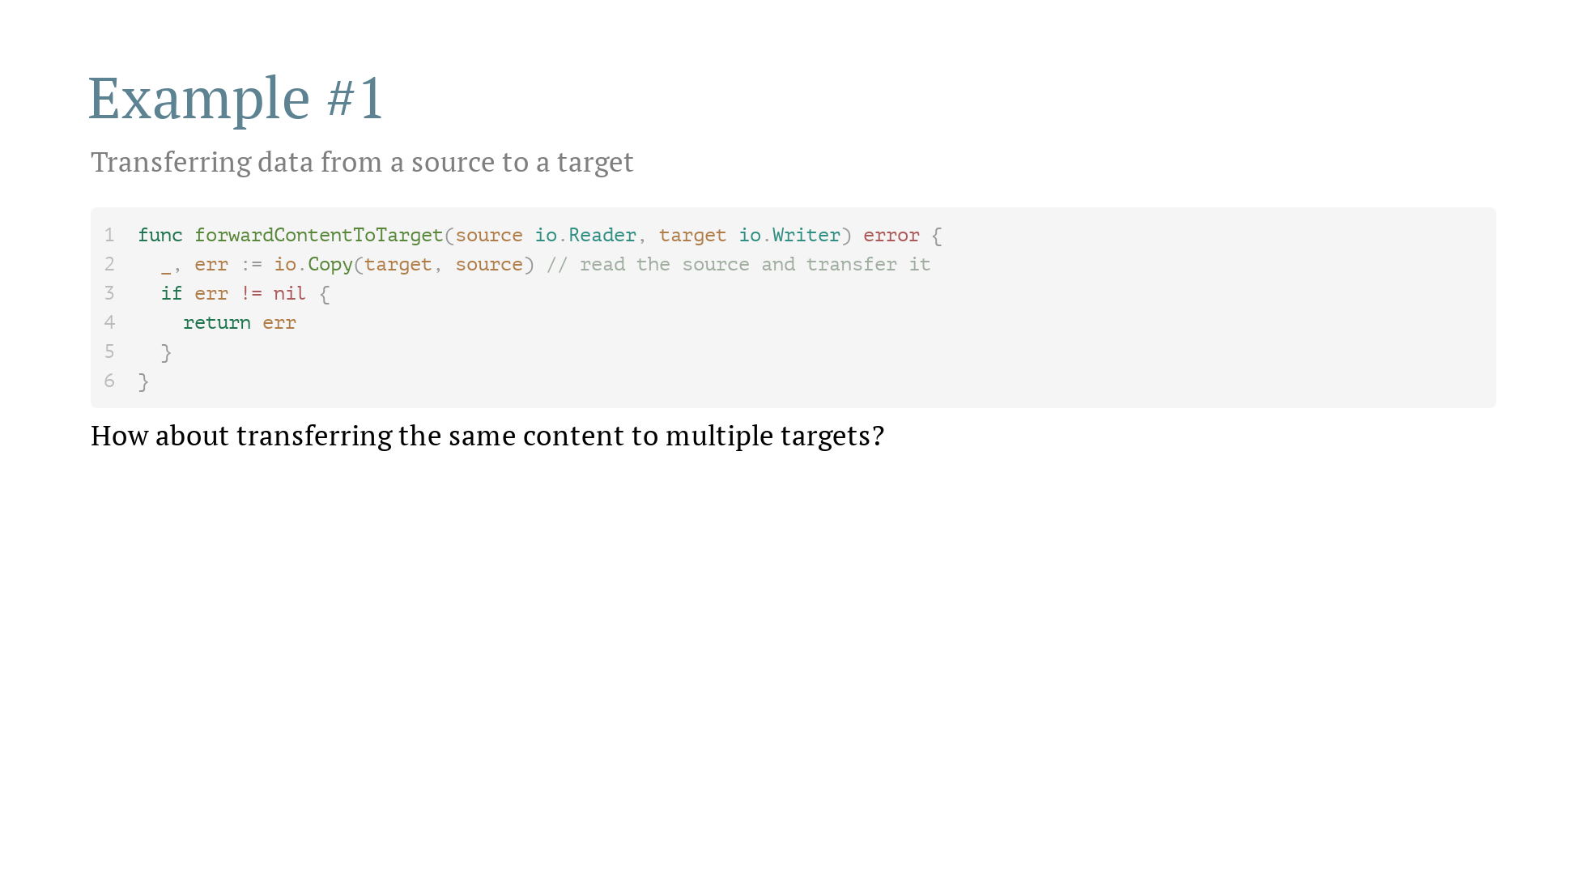

Slide 17
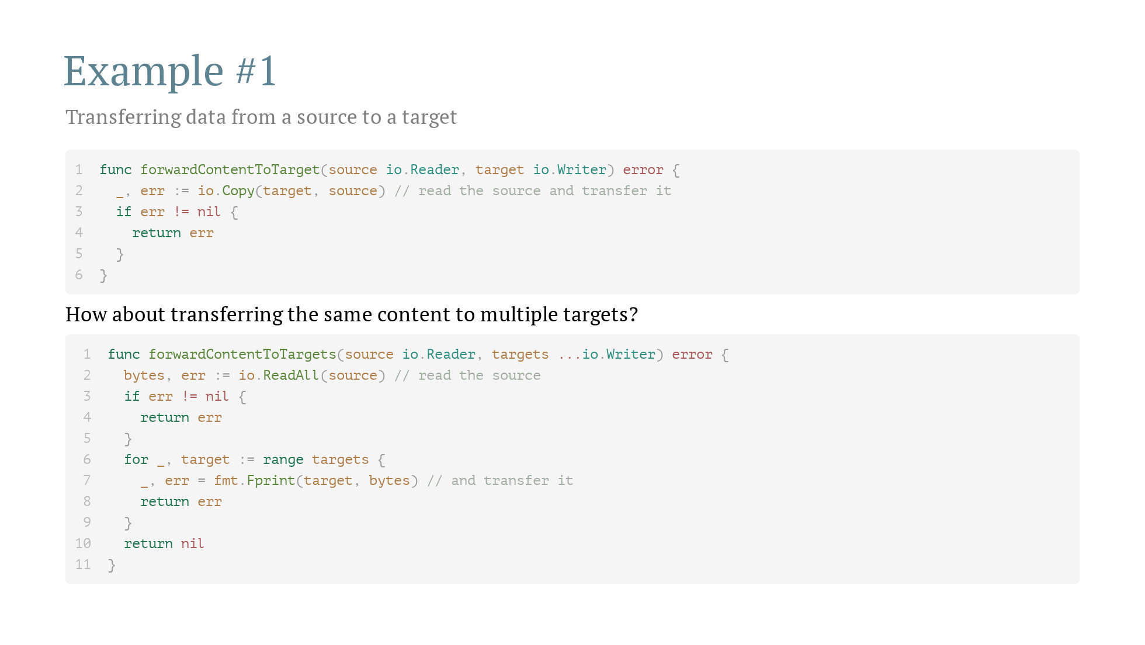

Slide 18
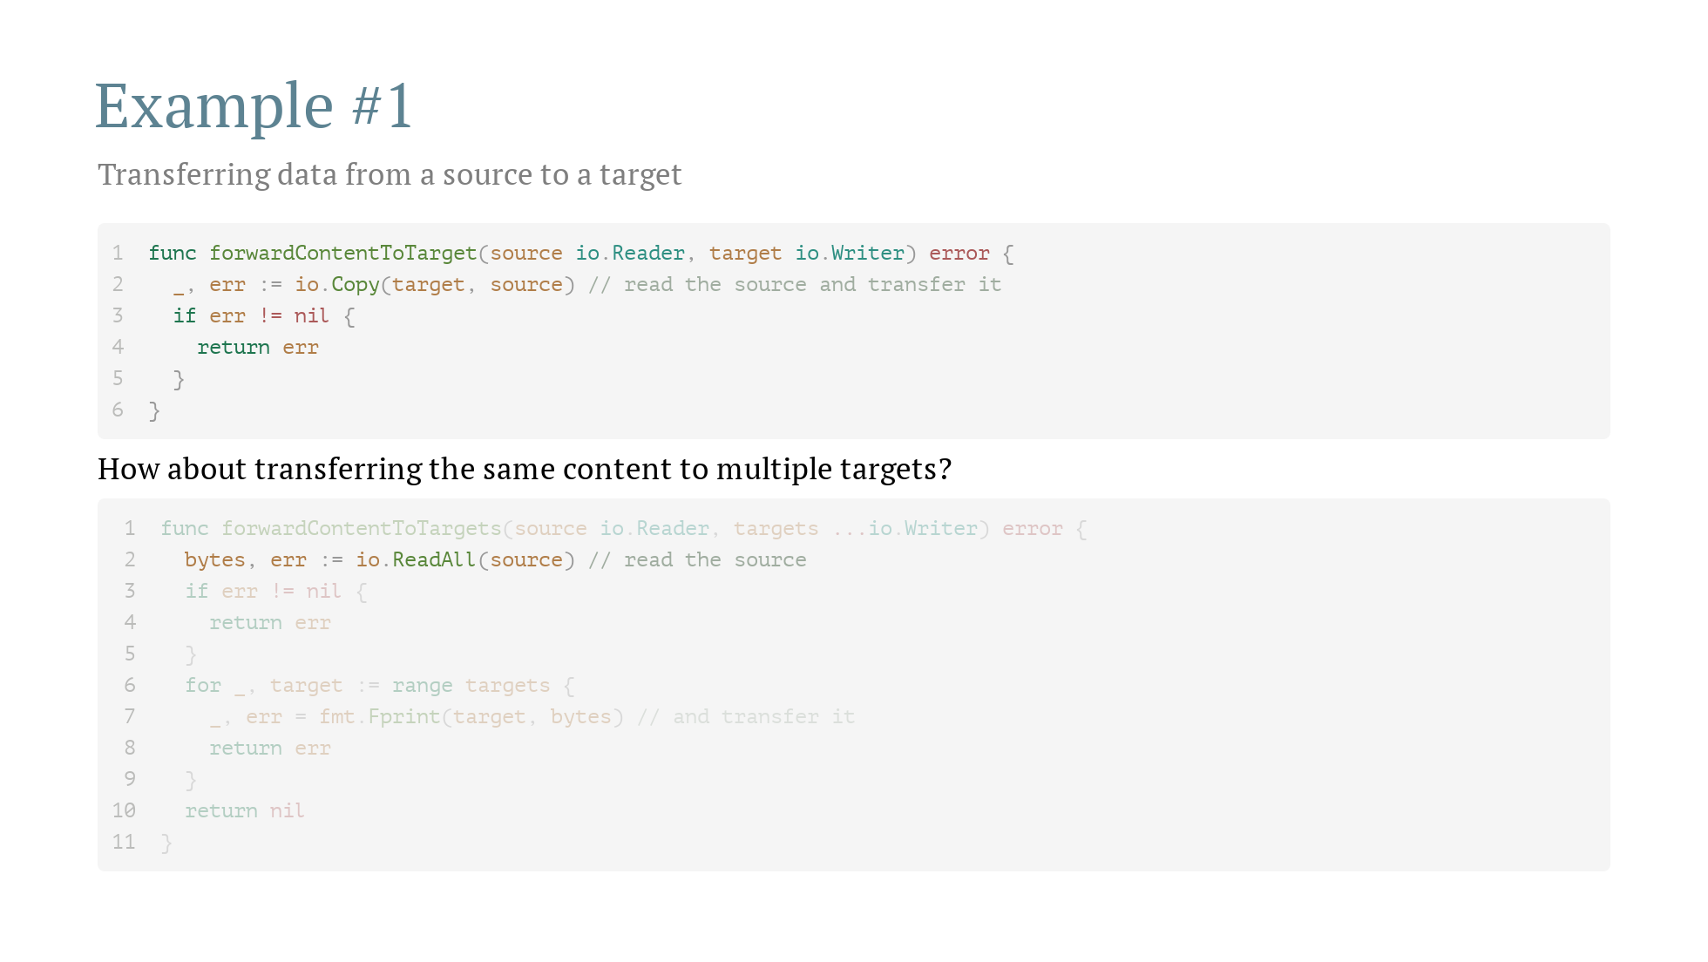

Slide 19
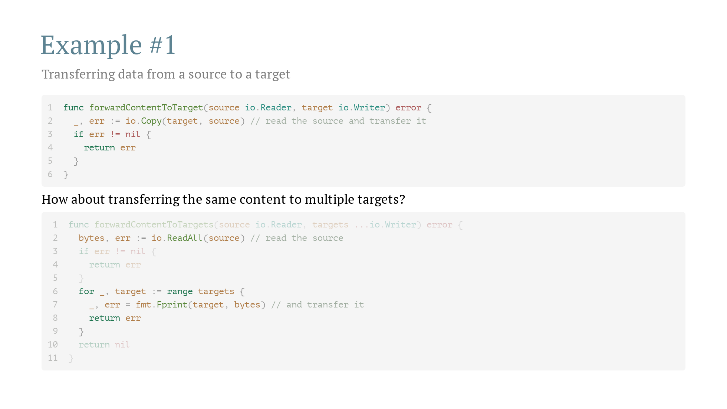

Slide 20
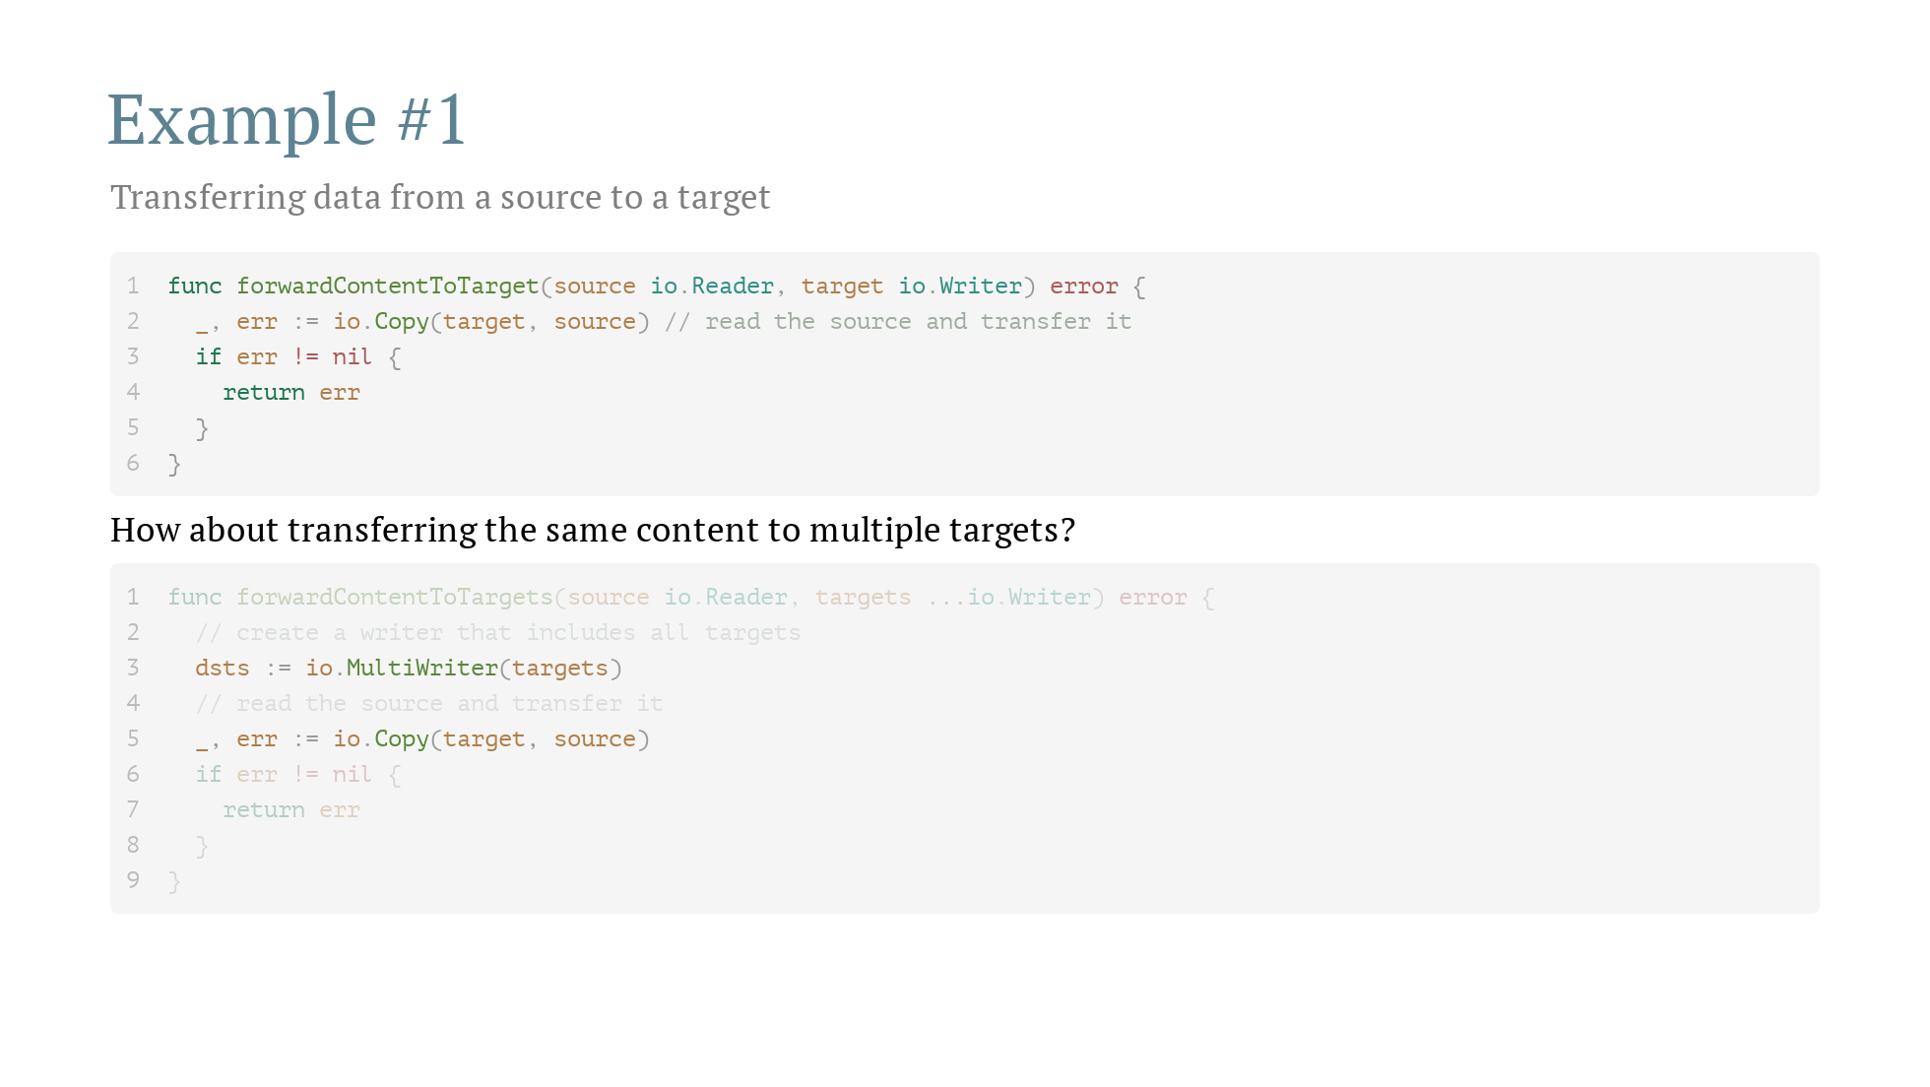

Slide 21
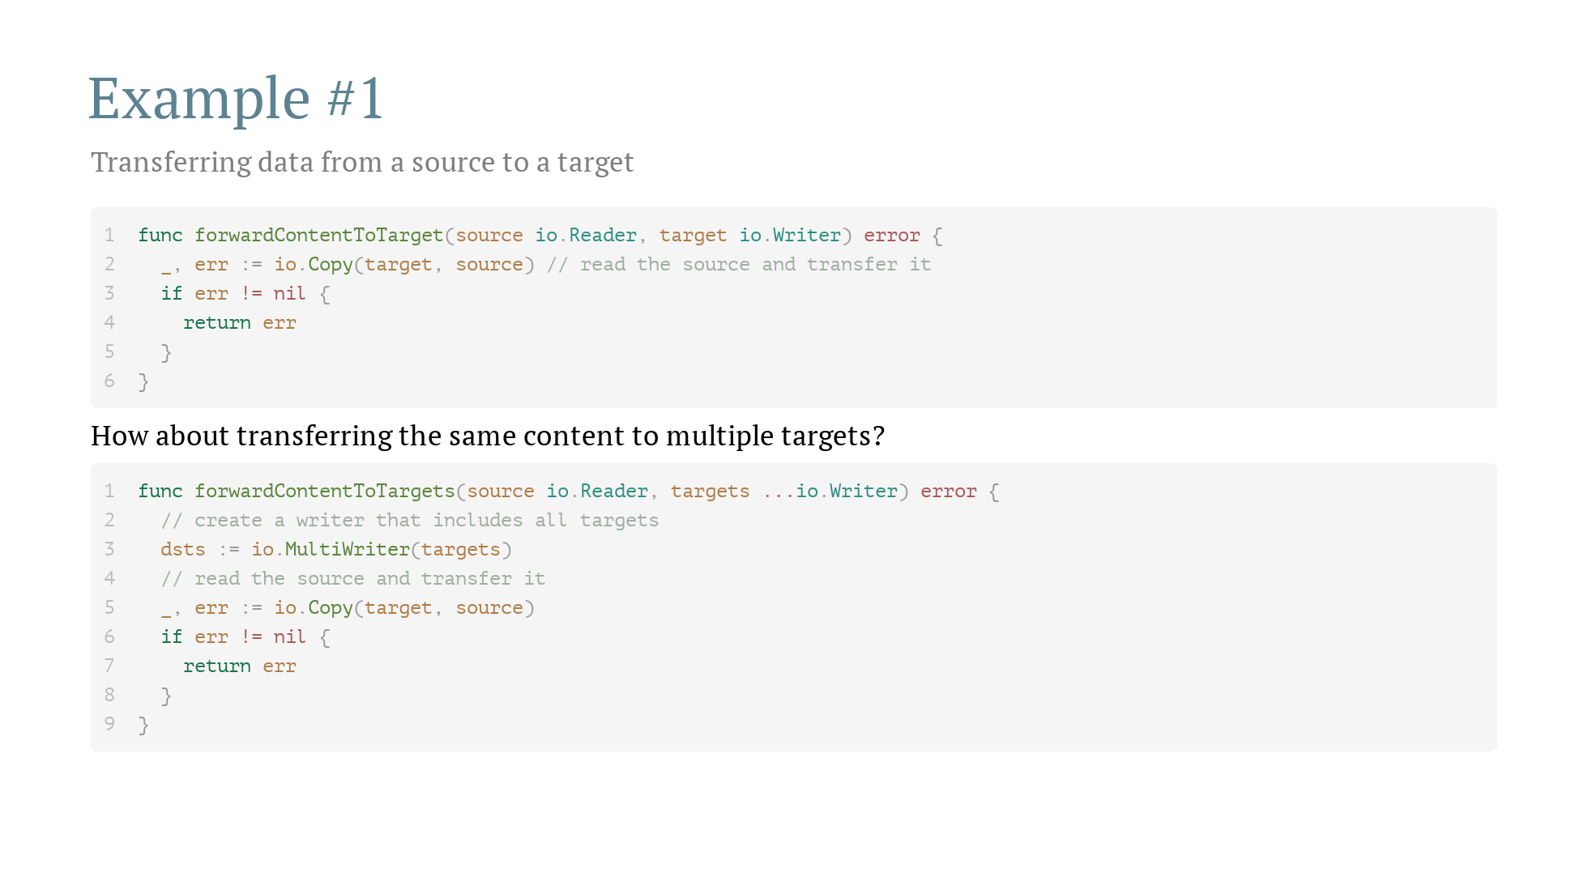

Slide 22
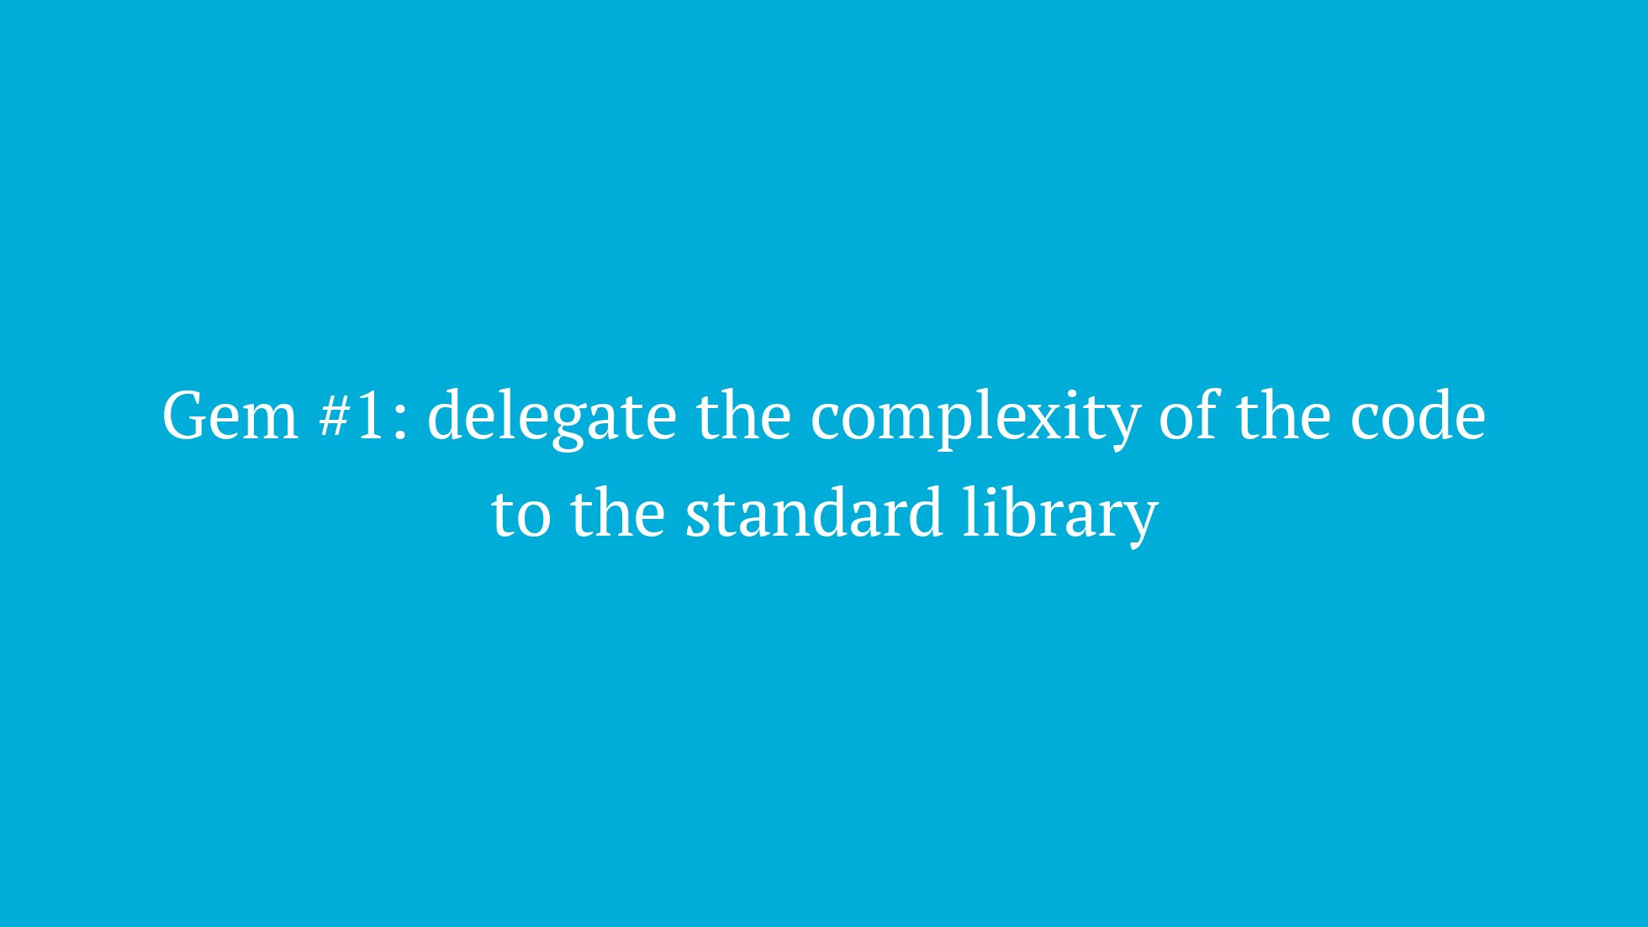

Slide 23

Notes:
Go [v1.13](https://tip.golang.org/doc/go1.13#error_wrapping) (Sep 2019) Go [v1.20](https://tip.golang.org/doc/go1.20#errors) (Feb 2023)

Slide 24
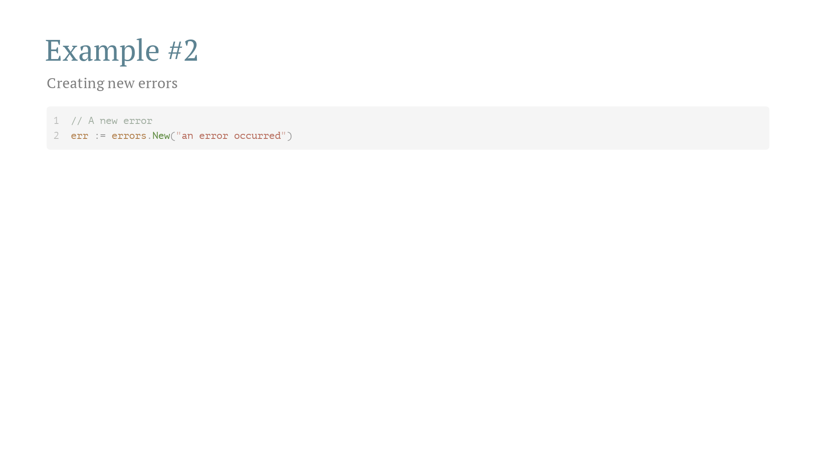
Notes:
Go [v1.13](https://tip.golang.org/doc/go1.13#error_wrapping) (Sep 2019) Go [v1.20](https://tip.golang.org/doc/go1.20#errors) (Feb 2023)

Slide 25
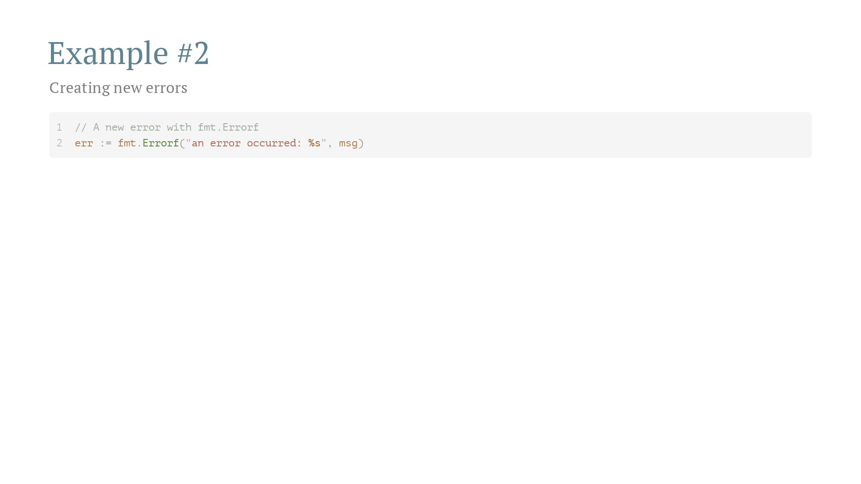
Notes:
Go [v1.13](https://tip.golang.org/doc/go1.13#error_wrapping) (Sep 2019) Go [v1.20](https://tip.golang.org/doc/go1.20#errors) (Feb 2023)

Slide 26
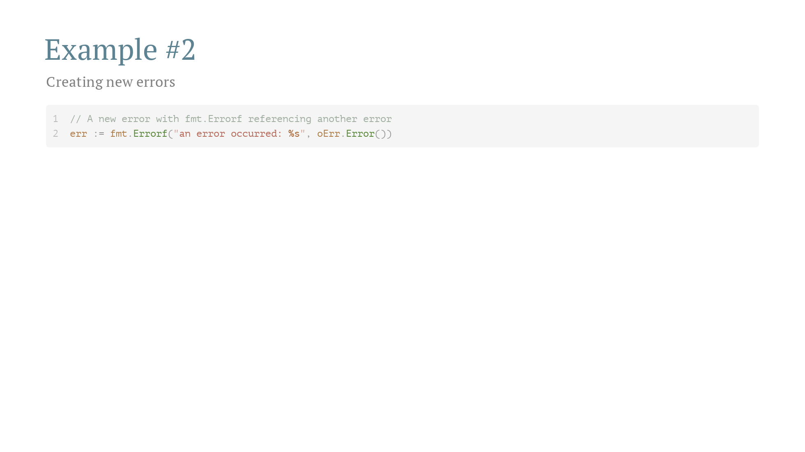
Notes:
Go [v1.13](https://tip.golang.org/doc/go1.13#error_wrapping) (Sep 2019) Go [v1.20](https://tip.golang.org/doc/go1.20#errors) (Feb 2023)

Slide 27
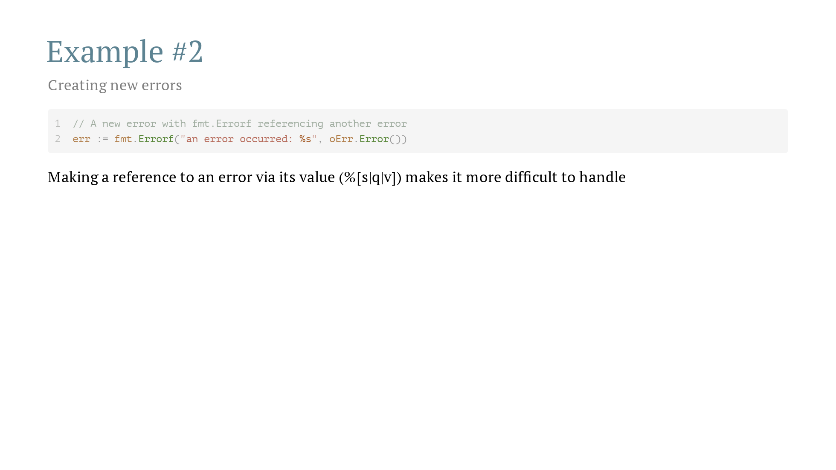
Notes:
Go [v1.13](https://tip.golang.org/doc/go1.13#error_wrapping) (Sep 2019) Go [v1.20](https://tip.golang.org/doc/go1.20#errors) (Feb 2023)

Slide 28
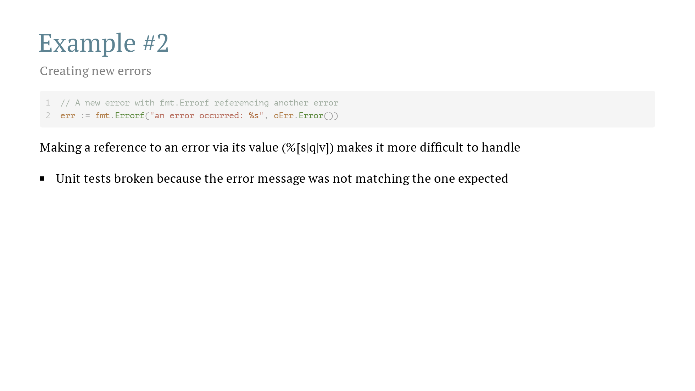
Notes:
Go [v1.13](https://tip.golang.org/doc/go1.13#error_wrapping) (Sep 2019) Go [v1.20](https://tip.golang.org/doc/go1.20#errors) (Feb 2023)

Slide 29
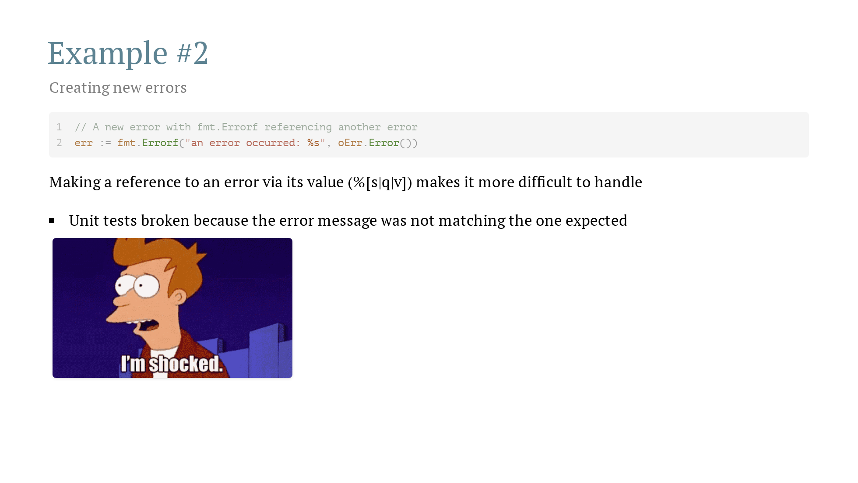
Notes:
Go [v1.13](https://tip.golang.org/doc/go1.13#error_wrapping) (Sep 2019) Go [v1.20](https://tip.golang.org/doc/go1.20#errors) (Feb 2023)

Slide 30
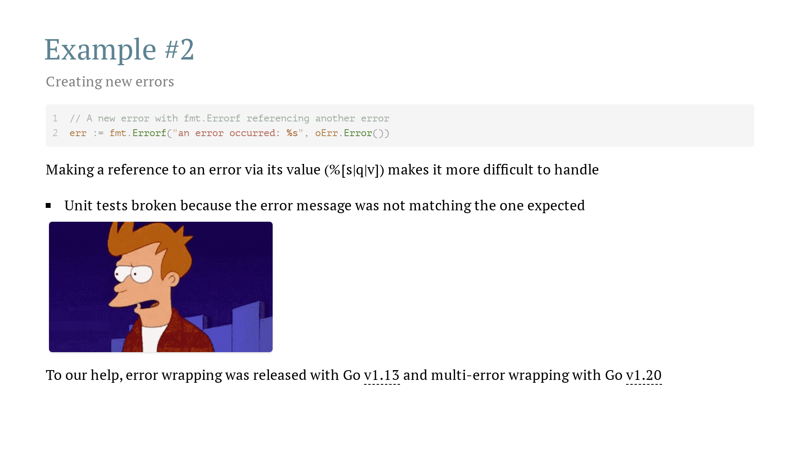
Notes:
Go [v1.13](https://tip.golang.org/doc/go1.13#error_wrapping) (Sep 2019) Go [v1.20](https://tip.golang.org/doc/go1.20#errors) (Feb 2023)

Slide 31
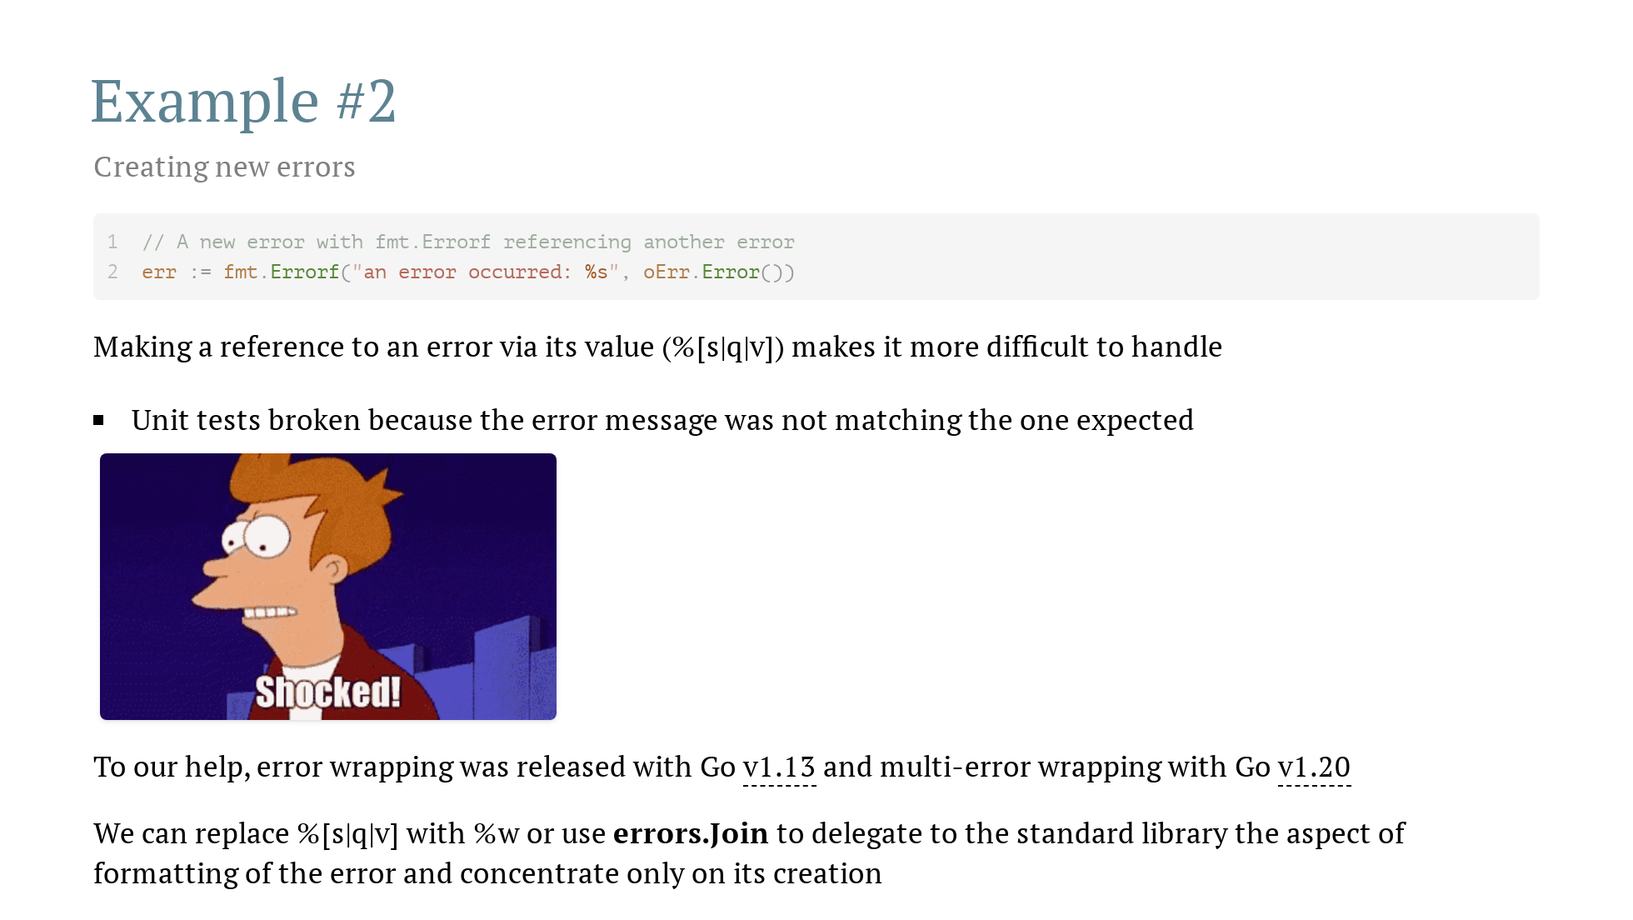
Notes:
Go [v1.13](https://tip.golang.org/doc/go1.13#error_wrapping) (Sep 2019) Go [v1.20](https://tip.golang.org/doc/go1.20#errors) (Feb 2023)

Slide 32
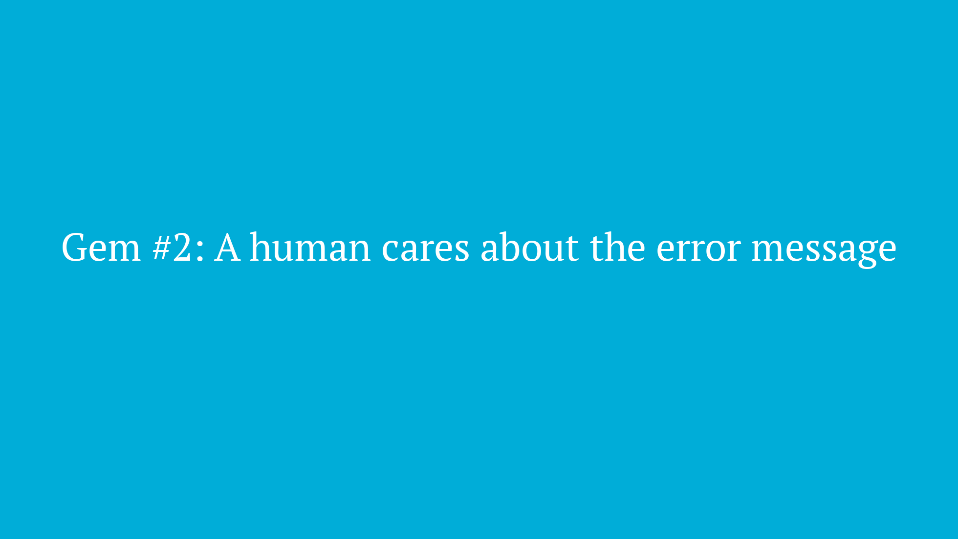
Notes:
and if you see fmt.Errorf still using %s to refer to error messages translate them to wrapped errors with no harm

Slide 33
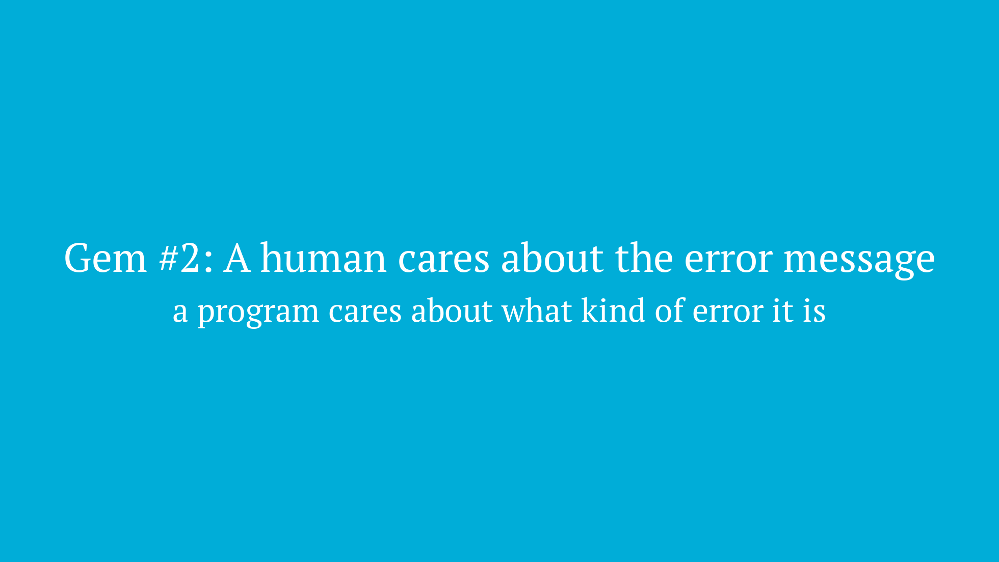
Notes:
and if you see fmt.Errorf still using %s to refer to error messages translate them to wrapped errors with no harm

Slide 34


Slide 35
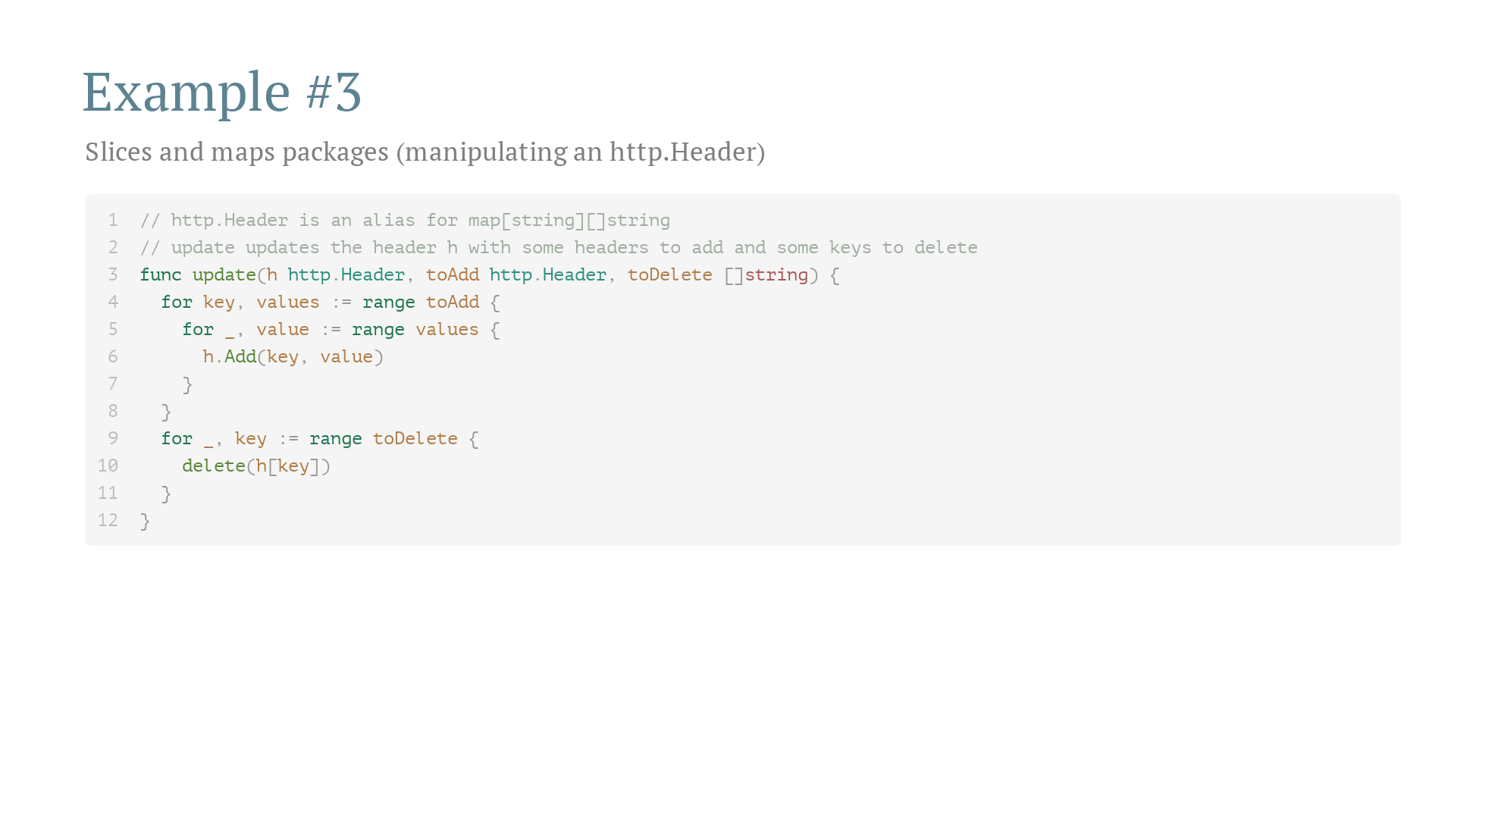

Slide 36
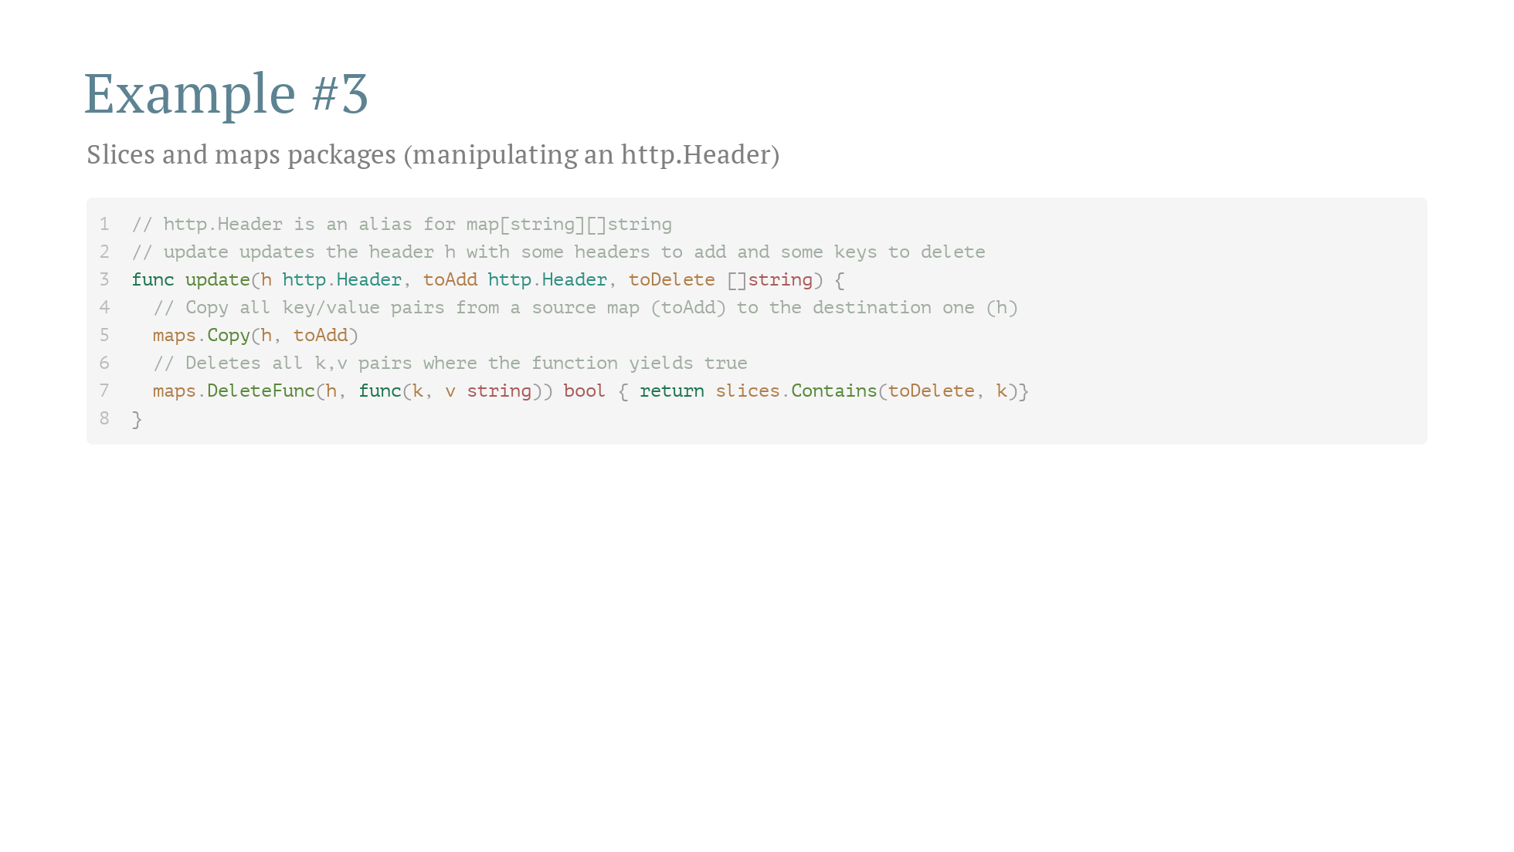

Slide 37
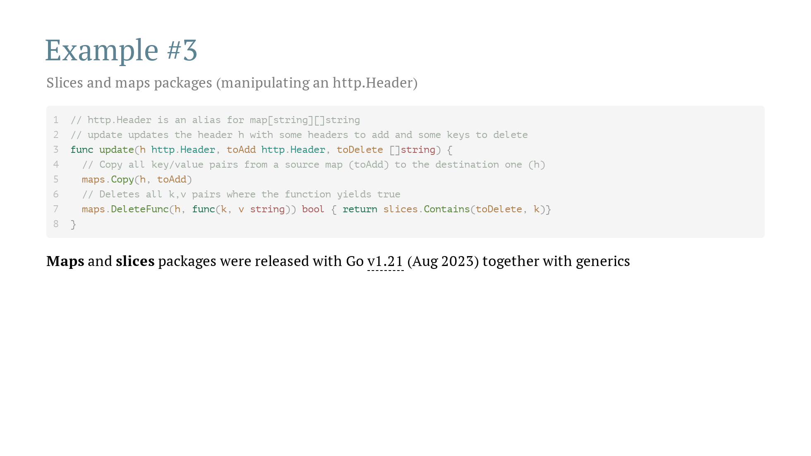

Slide 38
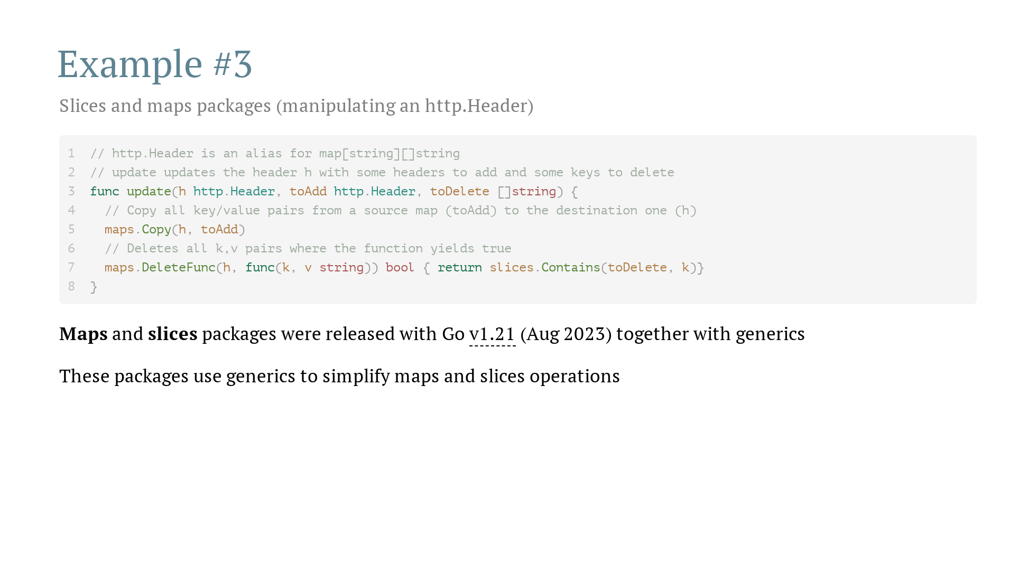

Slide 39


Slide 40


Slide 41


Slide 42


Slide 43


Slide 44


Slide 45


Slide 46
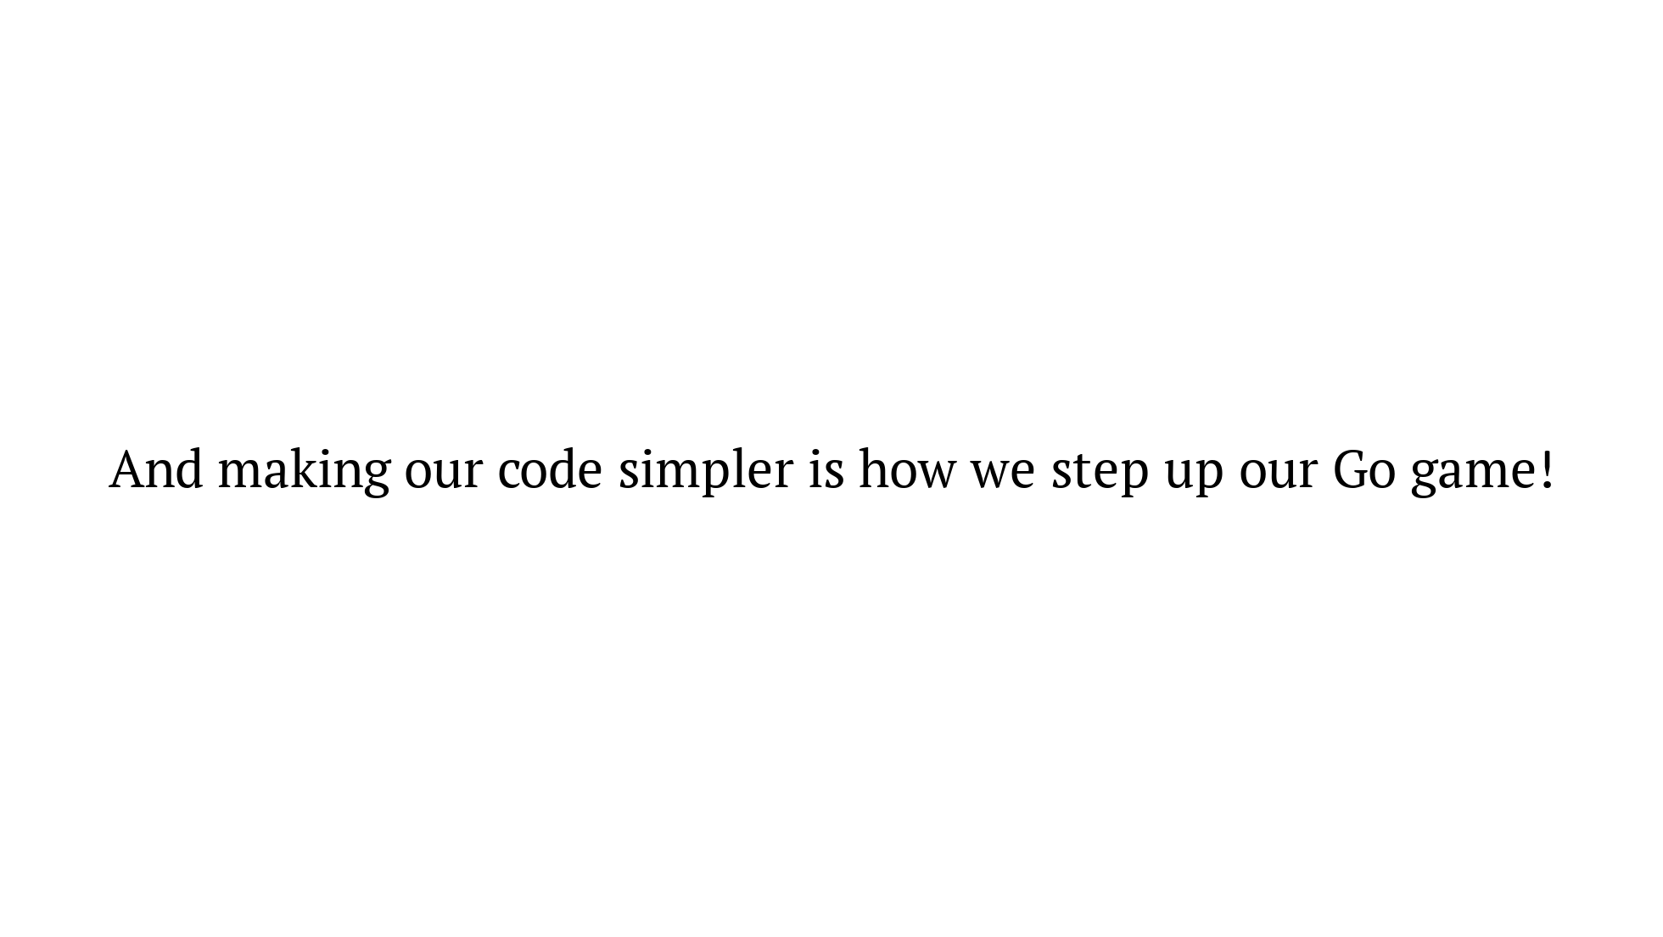

Slide 47


